Slide 1

Linguistic levels of structure
Sound
Phoneme
ð iː z b juː t ə f ʊ l w ɪ m ɪ n s ɛ d w iː w ɜː t r uː m ɛ n
Morpheme
These beauti-ful women said we were true men
Word
These beautiful women said we were true men
Phrase
These beautiful women said: “We were true men.”
Clause
C(These beautiful women said: “C(We were true men.)”)
Sentence
These beautiful women said: “We were true men.”
Meaning
?

Slide 2
Word structure
 | Prefix (Optional) | Root / Stem (Required) | Suffix (Optional)
Happy |  | Happy
Unhappy | Un- | happy
Happily |  | Happi | -ly | Suffixes can require some spelling changes in root
Unhappily | Un- | happi | -ly | Prefix and suffix can be added together
Industry |  | Industry
Industrial |  | Industri | -al
Industrialize |  | Industri | -al-ize | More than 1 suffixes can be added
Industrialization |  | Industri | -al-iz-ation
Change |  | Change
Non-interchange | Non-inter- | change |  | More than 1 prefixes can be added
Lists of common: prefixes, roots & prefixes, suffixes

Slide 3
Small test
Analyze the structure of these words: players, worker, working, inputting, output, thrilling, interestingly, amazed, amazingly, academy, unacademic, academically

Slide 4
Word classes
Old term: Parts of speech
Refers to the role that certain words play in a language
New term: Word classes
Refers to classes of words that have some characteristic or other in common

Slide 5
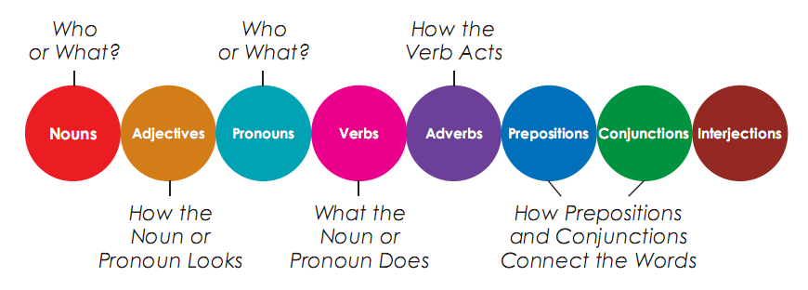
Way 1: Parts of speech
Traditional way

Slide 6
Way 2: Word classes
Open class
(content / lexical / autosemantic words)
Closed class
(Function / structure words)
Verb
Determiner
Noun
Conjunction
Adverb
Numeral
Preposition
Adjective
Interjection
Pronoun
Building blocks
The glue

Slide 7
Small test
Identify the word classes in these sentences
Tom loves Jerry like a cat loves a mouse.
Click on the left mouse button.
He likes to climb up mountains. What is wrong with that?
Gosh, we really envy you!
What a beautiful Christmas tree!
Tell me what happened, and I will give you what money I have.

Slide 8
Word classes
Open class
(content / lexical / autosemantic words)
Closed class
(Function / structure words)
Verb
Determiner
Noun
Conjunction
Adverb
Numeral
Preposition
Adjective
Interjection
Pronoun
Building blocks
The glue

Slide 9
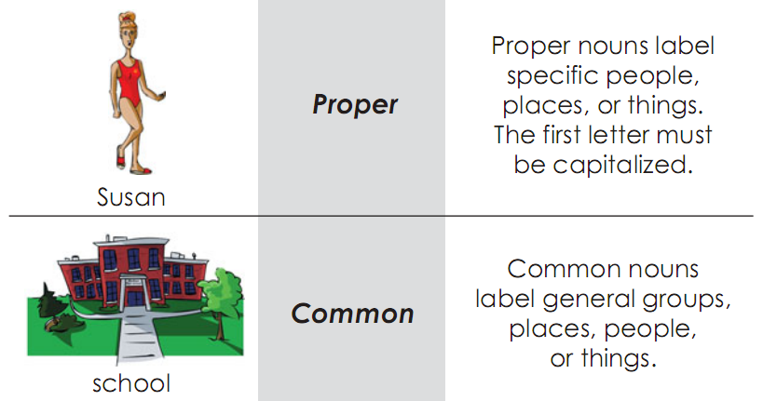
Nouns
Unique things
Other things
A noun refers to ‘things’ in the broadest sense (person, place, thing, idea, quality, action, etc.). If we have a noun for something, it implies that we view it as a ‘thing’.

Slide 10
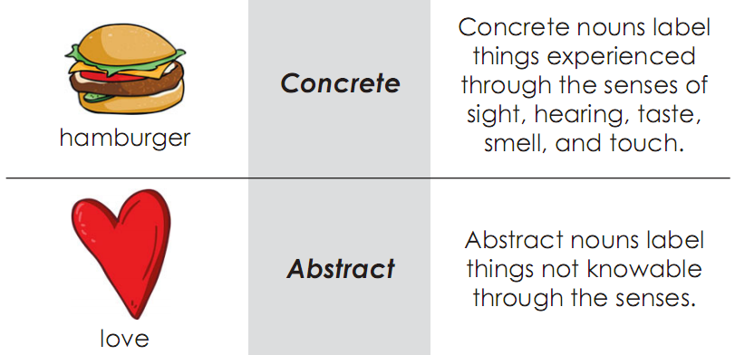
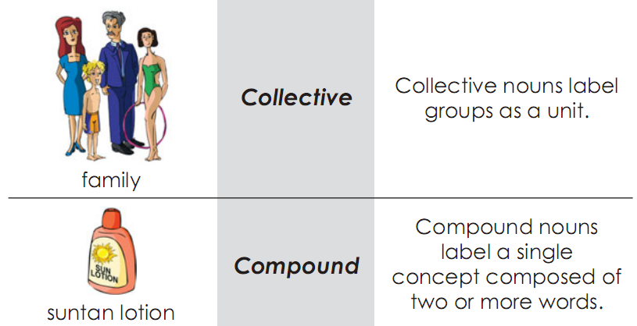
Common nouns
See:
- A sample list: http://users.tinyonline.co.uk/gswithenbank/collnoun.htm
- Origin: http://www.englishleap.com/grammar/collective-nouns
- Agreements: here
Perceivable
Others
A noun can belong to more than one group.
E.g. suntan lotion is both a common and a concrete noun, as well as a compound noun.

Slide 11
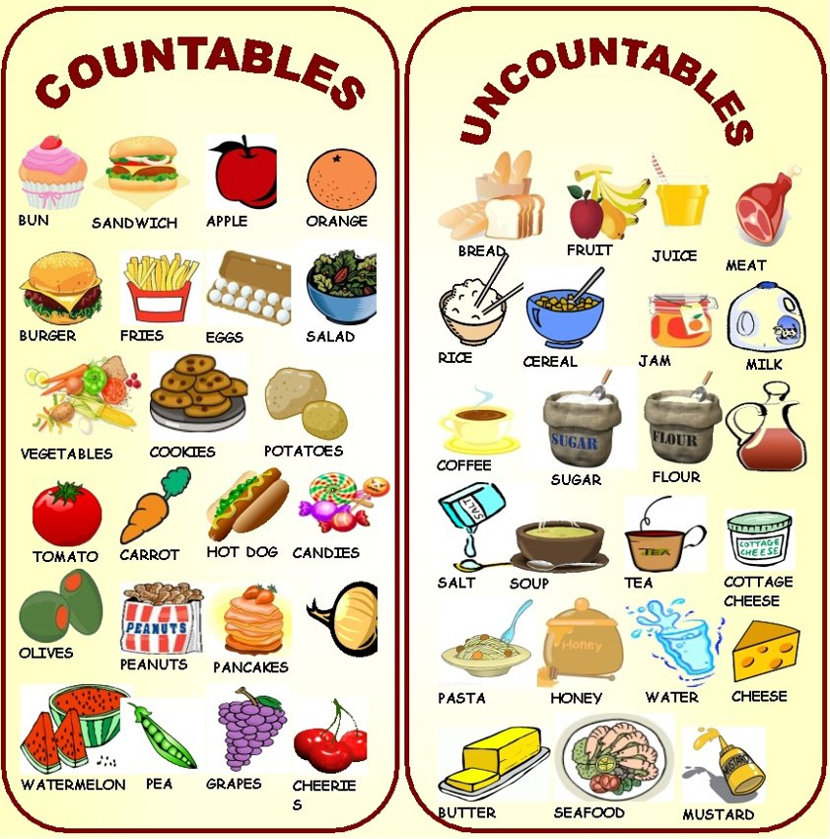
Common nouns
A noun can be classified as countable or uncountable (mass).
- Some nouns may be both depending on the context. E.g. I want some cake. and I have 6 cakes.
- Some mass nouns can be used as countable nouns to mean ‘a number of kind/portion of objects’. E.g. five cheeses, a beer.
- Mass nouns like flour and bread can only be made countable by prefixing some expression of measurement. E.g. six spoonful of flour.

Slide 12
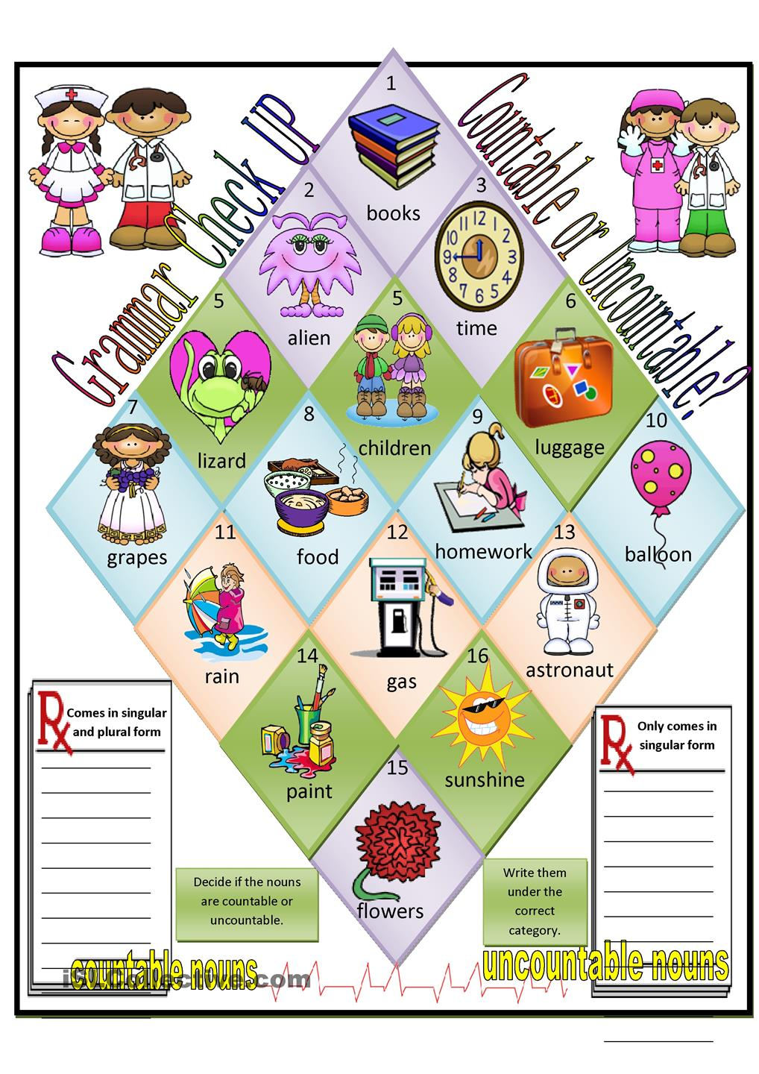
Small test

Slide 13
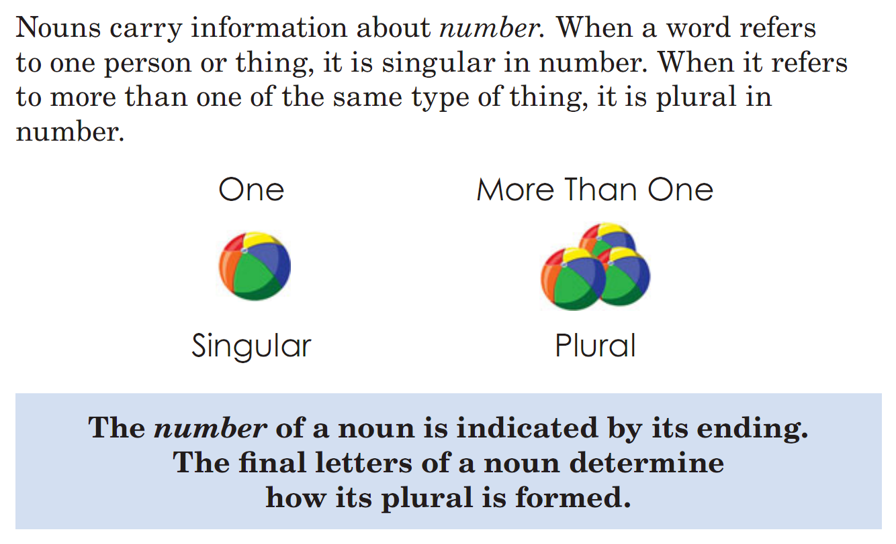
Noun forms

Slide 14
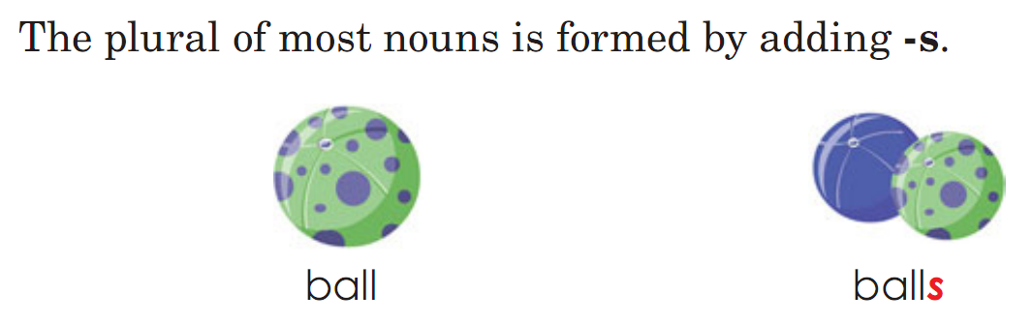
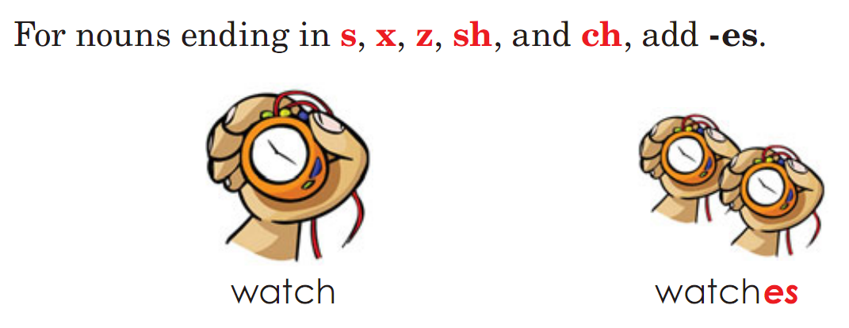
Noun forms

Slide 15
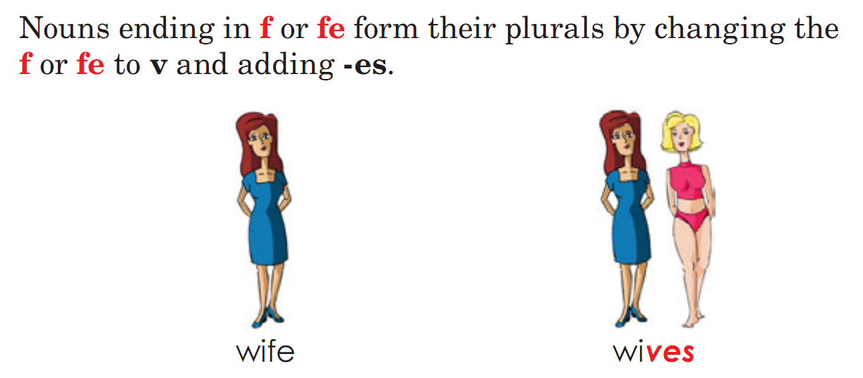
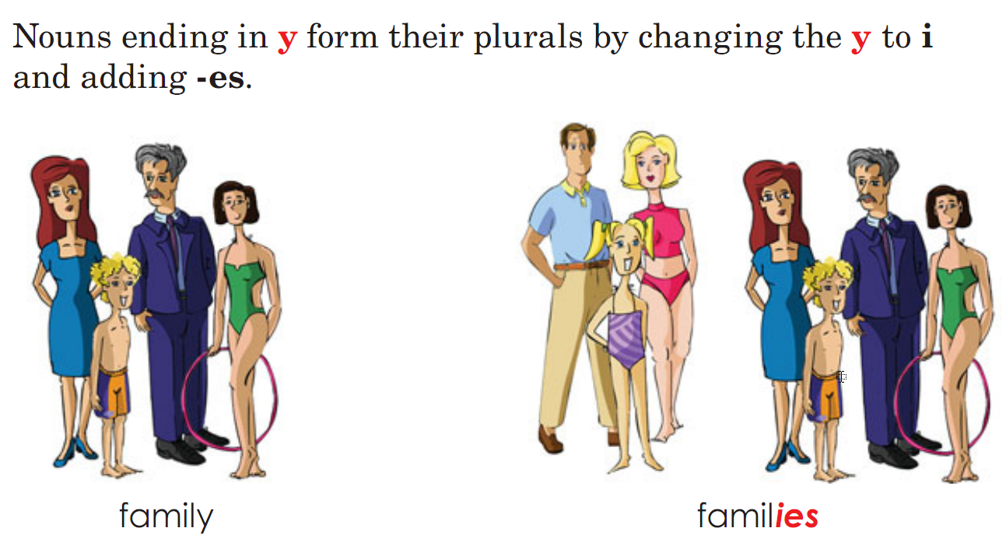
Noun forms
Take a look at other noun endings to discover other irregular noun plurals. See: http://www.edufind.com/english-grammar/plural-nouns/

Slide 16
Small test
What is the plural form of these nouns?
Boat, house, cat, wish, pitch, box, penny, spy, city, club, baby, watch, sky, hatch
Woman, man, child, foot, leaf, half, knife, wife, potato, thesis, focus, datum, mouse
Sheep, fish, deer, species, aircraft
News, athletics, linguistics, darts, billiards
Trousers, jeans, scissors

Slide 17
Small test
Are uncountable nouns always singular?
Are collective nouns always plural?

Slide 18

Any question?

